Slide 1
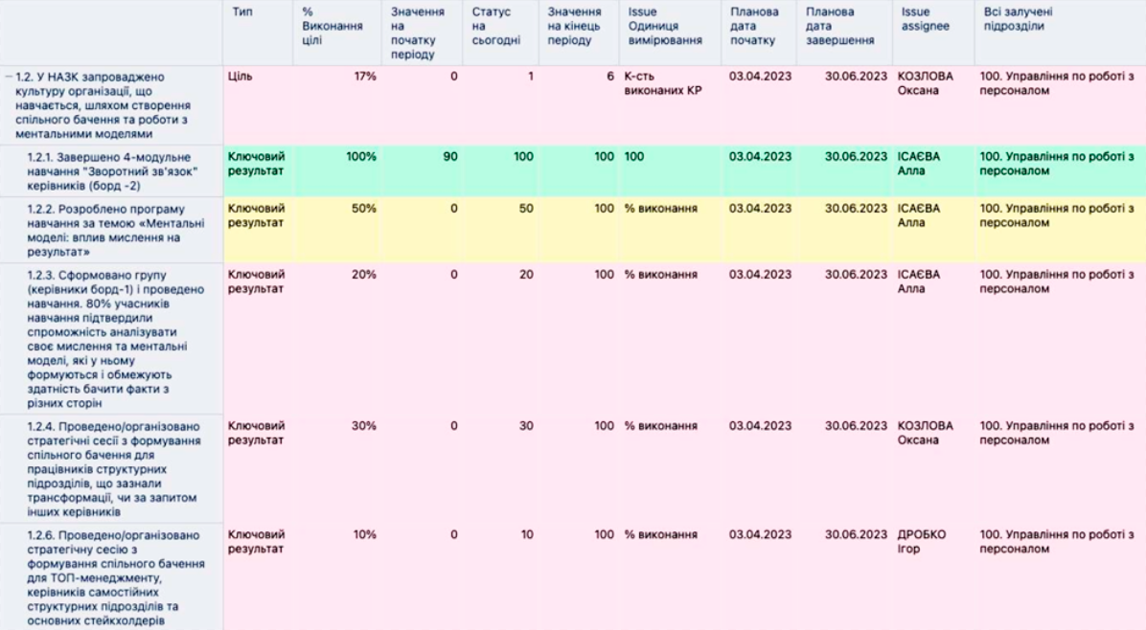
Biweekly assessment of progress towards achieving OKRs (Jira)
Annex 7
to the Procedure for planning the work of the National Agency on Corruption Prevention based on the Objectives and Key Results (OKR) methodology for the implementation of the Mission "Building Integrity in Government and a Just Society (clauses 9, 10 of Section 2, paragraph 1 of Section 3)
Додаток 7 до Порядку управління у Національному агентстві з питань запобігання корупції за методологією Цілей та ключових результатів (Objectives and Key Results (OKR)) для реалізації Місії: «Будуємо доброчесну владу та справедливе суспільство» (пункт 3 розділу ІІІ)
Type
% of goal completion
value at the beginning of the period
Current status
value at the end of the period
Unit of measurement
Planned start date
Planned end date
All involved units
1.2. The NACP has introduced a culture of a learning organisation by creating a common vision and working with mental models
Objective
Number of achieved KRs
KOZLOVA Oksana
100. Human Resources Department
1.2.1. Completed 4-module training "Feedback" for managers (board-2)
Key Result
ISAIEVA Alla
100. Human Resources Department
1.2.2. A training program on "Mental models: the impact of thinking on results" was developed
Key Result
% of completion
ISAIEVA Alla
100. Human Resources Department
1.2.3. A group (board-1 managers) was formed and training was conducted. 80% of training participants confirmed their ability to analyze their thinking and mental models that are formed in it and limit the ability to see facts from different angles
Key Result
% of completion
ISAIEVA Alla
100. Human Resources Department
1.2.4. Conducted/organized strategic sessions on forming a common vision for employees of structural units undergoing transformation or at the request of other managers
Key Result
% of completion
KOZLOVA Oksana
100. Human Resources Department
1.2.6 A strategic session was held/organized to develop a common vision for top management, heads of independent structural units and key stakeholders
Key Result
% of completion
DROBKO Igor
100. Human Resources Department

