Slide 1
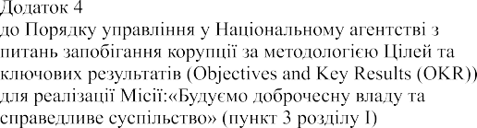
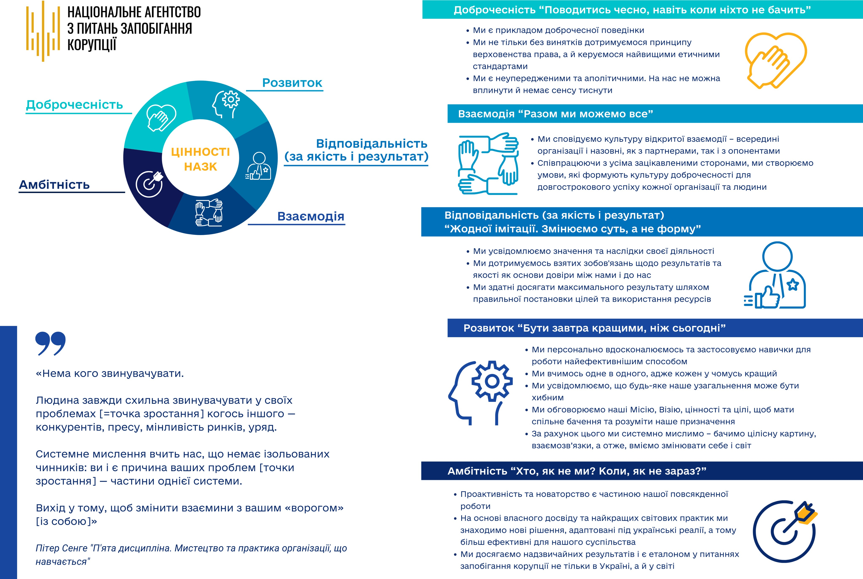
Annex 4
to the Procedure for planning the work of the National Agency on Corruption Prevention based on the Objectives and Key Results (OKR) methodology for the implementation of the Mission "Building Integrity in Government and a Just Society" (section 1, paragraph 3)
NATIONAL AGENCY ON CORRUPTION PREVENTION
Integrity “Behave with integrity, even when no one is looking”
We are an example of good behaviour
Not only do we adhere to the rule of law without exception, but we are also guided by the highest ethical standards
We are impartial and apolitical. We cannot be influenced and there is no point in putting pressure on us
Development
Integrity
Cooperation “Together, we can do anything”
Responsibility
(for quality and result)
We have a culture of open interaction - within the organisation and externally, with both partners and opponents
By working with all our stakeholders, we create an environment that fosters a culture of integrity for the long-term success of every organisation and individual
NACP’S VALUES
Ambitiousness
Cooperation
Responsibility (for quality and results)
"No imitation. We change the essence, not the form"
We understand the significance and impact of our activities
We honour our commitments to results and quality as a basis for trust between us and in us
We are able to achieve maximum results by setting goals and using resources appropriately
Development “Be better tomorrow than today”
We are personally improving and applying our skills to work in the most effective way
We learn from each other, because everyone is better at something
We realise that any generalisation we make may be wrong
We discuss our Mission, Vision, values and goals to share a common vision and understand our purpose
Due to this, we think systematically - we see the whole picture, interconnections, and therefore, we are able to change ourselves and the world
“There’s no one to blame.
People always tend to blame someone else for their problems
(= growth point) - competitors, the press, market volatility, the government.
Systems thinking teaches us that there are no isolated factors: you are the cause of your problems (growth points) - part of a system.
The way out is to change the relationship with your "enemy" (yourself)”
Peter Senge, "The Fifth Discipline. The Art and Practice of the Learning Organization"
Ambitiousness “Who but us? When if not now?”
Proactivity and innovation are part of our daily work
Based on our own experience and the best international practices, we find new solutions adapted to Ukrainian realities and therefore more effective for our society
We achieve extraordinary results and are a benchmark in the prevention of corruption not only in Ukraine but also in the world

