Slide 1
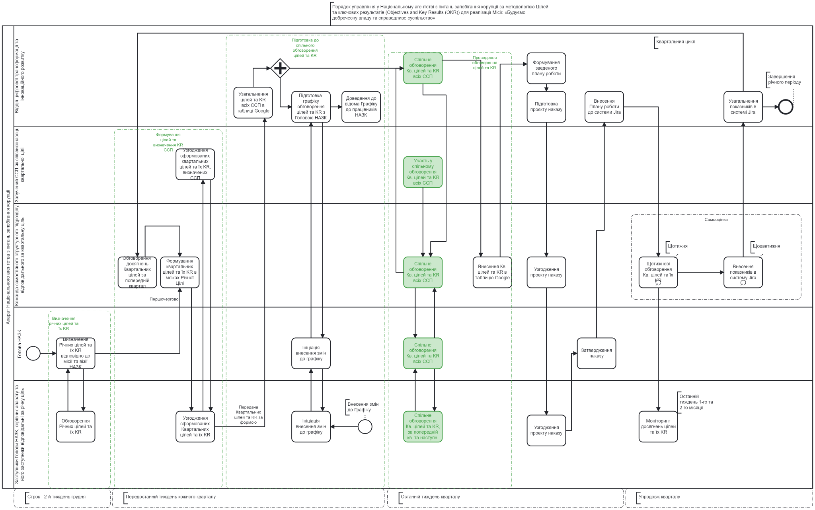
Annex 2
to the Procedure for planning the work of the National Agency on Corruption Prevention based on the Objectives and Key Results (OKR) methodology for the implementation of the Mission "Building Integrity in Government and a Just Society (clause 7 of Section 1)
Management Procedure in the National Agency for the Prevention of Corruption based on the Objectives and Key Results (OKR) methodology for the implementation of the Mission "Building Integrity in Government and a Just Society"
Preparing for a joint discussion of goals and KR
Quarter cycle
Joint discussion of Quarterly goals and KRs of all ISUs
Conducting a discussion of goals and KR
Formation of a consolidated work plan
Department of Digital Transformation and Innovative Development
End of annual period
Summarise the goals and KRs of all ISUs in a Google spreadsheet
Prepare a schedule for discussing goals and KR with the NACP Head
Communicate the Schedule to the NACP employees
Entering the Work Plan into the Jira system
Summarising indicators in the Jira system
Preparation of a draft order
Setting goals and defining the KR of the ISU
Involved MTP as a co-executor of the quarterly target
Reconciliation of the quarterly targets and their KRs determined by the ISU
Participation in the joint discussion of the Quarterly targets and KRs of all ISUs
Self-assessment
Team of an independent structural unit responsible for the quarterly target
Weekly
Biweekly
Staff of the National Agency on Corruption Prevention
Discussion of the achievement of the previous quarter's Quarterly Goals
Setting quarterly goals and their KR within the Annual Goal
Joint discussion of the Quarterly targets and KRs of all ISUs
Entering quarterly goals and KRs into a Google spreadsheet
Weekly discussions of the Quarterly Objectives and their KR
Entering indicators into the Jira system
Approval of the draft order
Firsthand
Defining Quarter Goals and their KR
Head of the NACP
Defining Annual Goals and KRs according to the Mission and Vision of the NACP
Initiation of making changes to the Schedule
Joint discussion of the Quarterly targets and KRs of all ISUs
Approval of the order
Submission of quarterly targets and KRs in appropriate form
Making changes to the Schedule
The last week of the 1st and the 2nd month
Discussing Annual Goals and their KRs
Coordination of the formed Quarterly targets and their KR
Initiation of making changes to the Schedule
Joint discussion of the Quarterly targets and KRs of all ISUs for the Current and the Quarter
Approval of the draft order
Monitoring the achievement of goals and their KR
Deputy Heads of the NACP, the Chief of Staff and his/her deputies are responsible for the annual target
Deadline – second week of December
The second last week of each quarter
The last week of the quarter
During the quarter

