Slide 1
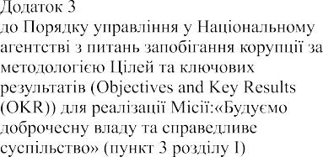

Annex 3
to the Procedure for planning the work of the National Agency on Corruption Prevention based on the Objectives and Key Results (OKR) methodology for the implementation of the Mission “Building Integrity in Government and a Just Society” (Section 1, paragraph 3)
VISION
WE ARE CHAMPIONS OF INTEGRITY
A proactive, highly qualified team that is a leader of the anti-corruption movement and an example of an effective state institution
MISSION
BUILDING INTEGRITY IN THE GOVERNMENT AND A JUST SOCIETY
To do this, we make the public sector accountable, corruption difficult and unacceptable, and anti-corruption processes effective, convenient and unburdensome

