Slide 1
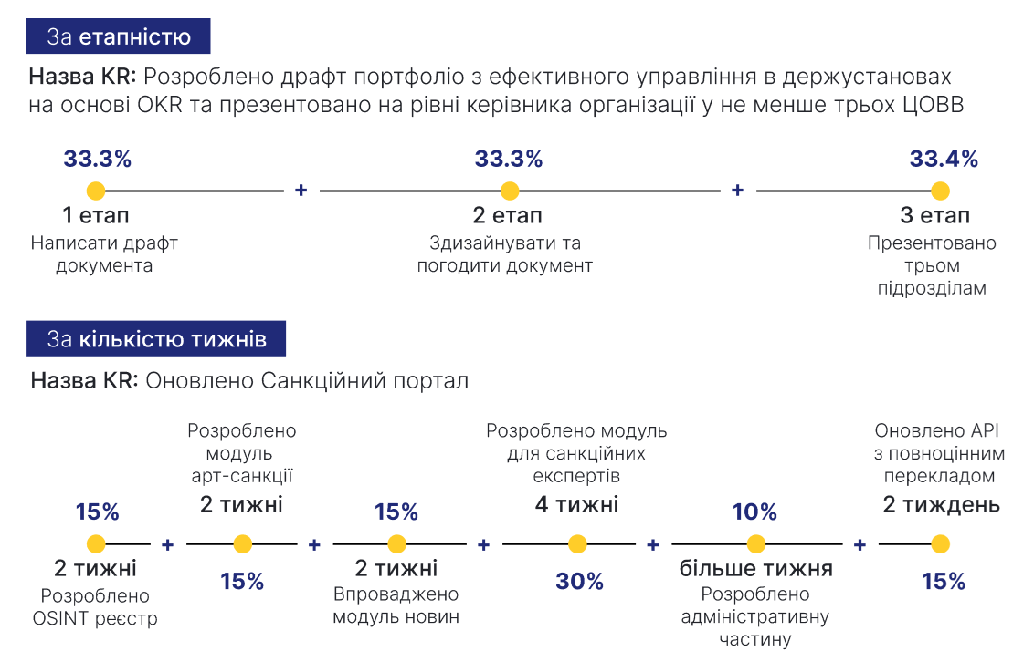
Measuring weekly progress on key deliverables throughout the quarter
Annex 6
to the Procedure for planning the work of the National Agency on Corruption Prevention based on the Objectives and Key Results (OKR) methodology for the implementation of the Mission "Building Integrity in Government and a Just Society (clauses 9, 10 of Section 2, paragraph 1 of Section 3)
Додаток 6 до Порядку управління у Національному агентстві з питань запобігання корупції за методологією Цілей та ключових результатів (Objectives and Key Results (OKR)) для реалізації Місії: «Будуємо доброчесну владу та справедливе суспільство» (пункт 2 розділу ІІІ)
1
By stage
Name of the KR: Draft portfolio on effective management in public institutions based on OKRs developed and presented at the level of the head of the organisation in at least three central executive authorities
1st stage 2nd stage 3rd stage
Write a draft of the document
Design and approve the document
Present the document to three units
2
By number of weeks
Name of the KR: Sanctions portal has been updated
An art sanction module has been developed
A module for sanctions experts has been developed
Updated API with full translation
2 weeks
2 weeks
2 weeks
2 weeks
2 weeks
more than a week
An OSINT-register has been developed
A news module has been implemented
An administrative part has been developed

Slide 2
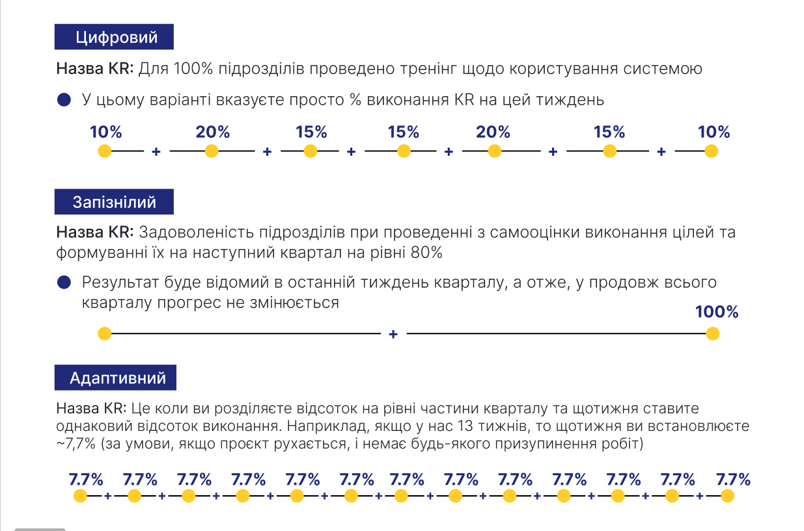
Measuring weekly progress on key deliverables throughout the quarter
Продовження додатка 6
Continuation of Annex 6
3
Numeric
The name of KR: 100% of units have been trained on how to use the system
In this variant, you simply indicate the % of KR fulfilment for this week
4
Delayed
The name of KR: 80% satisfaction of units with self-assessment of goals achievement and setting them for the next quarter
The result will be known in the last week of the quarter, which means that progress remains unchanged throughout the quarter
5
Adaptive
The name of KR: This is when you divide the percentage into equal parts of the quarter and set the same percentage of completion each week. For example, if we have 13 weeks, then every week you set ~7.7% (assuming the project is moving and there is no suspension of work)

